Slide 1

Sentiment Analysis for Product Rating
A Major Project on
B.Shashidhar
15841A1206
Department of Information Technology
Aurora’s Technological and Research Institute
Name of the Guide:
Ms. V.Aruna

Slide 2
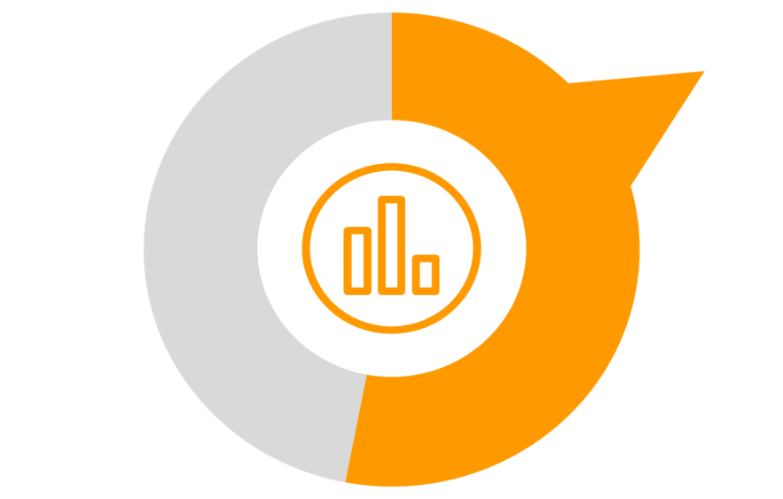
Index
Introduction
Abstract
Existing System
Proposed System
Advantages and Disadvantages
Key Terms
Software Requirements
Hardware Requirements
Conclusion

Slide 3
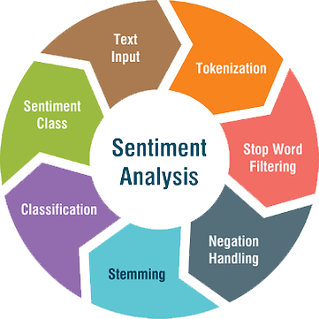
Introduction
What is Sentiment Analysis ?
The process of computationally identifying and categorizing opinions expressed in a piece of text, especially in order to determine whether the writer's attitude towards a particular topic, product, etc. is positive, negative, or neutral.

Slide 4

What do you mean by Product Rating ?
Product ratings are the star ratings that customers give to your products. These ratings are important in building your e-commerce brand’s reputation online because they let shoppers know at a glance that you are highly rated and trusted by previous shoppers.

Slide 5
Abstract
Sentiment analysis is a rapidly emerging domain in the area of research in the field of Natural Language Processing (NLP). It has gained much attention in recent years. Sentiment classification is used to analyze the comments as well as ratings given by the user to extract the opinion from it. Sentiment analysis is a machine learning approach in which machines classify and analyze the human’s sentiments, emotions, opinions etc. about the products which are expressed in the terms of text, numbers, star rating, thumbs up and thumbs down. The data used in this study is online product reviews collected from the sample website that we have created. Words such as adjectives and adverbs are able to convey opposite sentiment with the help of negative prefixes. Negation phrase identification algorithm is used to get such results. The performance is evaluated through evaluation measures.

Slide 6

Existing System
There is no such Existing System or an Application for Sentiment Analysis for Product Rating which can provide rating about the product whether it is good or bad to buy those products from the E-Commerce applications. Most of the feedbacks are taken through calls and sms which don’t provide any analytics to the buyer which may lead to buying duplicate and bad products from the E-Commerce websites.

Slide 7

Proposed System
We propose an advanced Sentiment Analysis for Product Rating that detects sentiments in comments and different types of emotion expression symbols from the different applications. The Application uses sentiment analysis approach in order to achieve desired outcomes. This project is an E-Commerce web application where the all user will view the product and their features and will comment provides rating about the products. The Application takes comments of various users, based on the comment, Application will specify whether the product is good, bad, or worst. This application provides an advertisement which makes people aware about the best rated products in online shopping. This Application is also useful for the sellers who need reviews on their products.

Slide 8
Advantages & Disadvantages
Advantages
User can easily share his view about the product.
People can easily decide whether the product posted is good or bad by using this application.
This application is more useful for the users who love to give review about the product.
Since system rates the product based on the weight age of the keywords in database, so the result is appropriate.
Disadvantages
Reduces the invention of new brand products as the new products don’t assure better quality until it is used and reviewed by some other persons.

Slide 9
Literature Survey
Existing System
An advanced Sentiment Analysis for Product Rating system that detects hidden sentiments in comments and rates the product accordingly. The system uses sentiment analysis methodology in order to achieve desired functionality. This project is an E-Commerce web application where the registered user will view the product and product features and will comment about the product. System will analyze the comments of various users and will rank product. We use a database of sentiment based keywords along with positivity or negativity weight in database and then based on these sentiment keywords mined in user comment is ranked. Comment will be analyzed by comparing the comment with the keywords stored in database. The System takes comments of various users, based on the comment, system will specify whether the product is good, bad, or worst. Once user login the system he can view the product and product features. After viewing product user can comment about the product. User can also view comment of other user’s. The role of the admin is to add product to the system and to add keywords in database. User can easily find out correct product for his usage. This application also works as an advertisement which makes many people aware about the product. This system is also useful for the users who need review about a product.

Slide 10
Advantages & Disadvantages
Advantages
User can easily share his view about the product.
People can easily decide whether the product posted is good or bad by using this application.
This application is more useful for the users who love to give review about the product.
Since system rates the product based on the weight age of the keywords in database, so the result is appropriate.
Disadvantages
System will match the comment with those keywords which are in database rest of the words are ignored by the system.
Rating can’t be calculated based on the comments provided by the user.
Reports of various products sentiments are not analyzed.
Graphs, Pie charts and bar graphs for the product reviews are not available.

Slide 11
Literature Survey
Existing System – 2
The basic purpose of analyzing the review is to help buyer to decide whether product is good or what. Usually if we want to buy anything online we will first go to the website and see how many people have recommended the product? How many people have rated the product as 5*? What are the pros and cons of the product? Etc. Nowadays websites also provide compare options, which will allow the user to compare two or more products and take decision if the buyer is in confusion. Current work uses data mining algorithm, such as ROCK for clustering and for classification CART algorithm along with various mechanisms. The need of this application is to show an analysis of customer opinions on decision making. It will help the customer to decide whether the product is good or bad and which product is best and customer to choose among variety of product by seeing reviews of the products.

Slide 12
Advantages & Disadvantages
Advantages
ROCK clustering technique used link for data concerning links among two points and while making decision on those points to be combined into one cluster.
The Classification and Analysis of laptop product reviews for the flipkart website is achieved by using ROCK and CART algorithms.
The Details and Reviews of the products are fetched using API’s
Disadvantages
Complexity and inability to recover from database corruption.
Requires API keys from third party e-commerce Applications.
Polarity of the products can’t be used for data analytics for future predictions.
Application Development is platform dependent and can be used only by administrator on the single system.

Slide 13
Modules
Product Management Module: Used for managing the Product details.
Sentiments Module : Used for managing the details of Sentiments
Graphs and Analysis Module : Used for managing the details of Graphs and Analysis
Category Management Module: Used for managing the information and details of the Category.
Customer Module : Used for managing the Customer details
Comments Module : Used for managing the Comments information
Login Module: Used for managing the login details
Users Module : Used for managing the users of the system

Slide 14
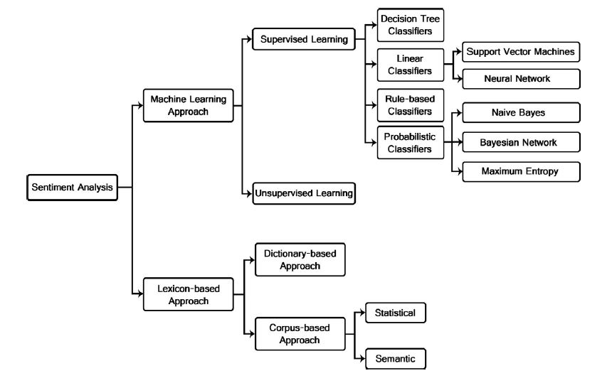
APPROACHES

Slide 15
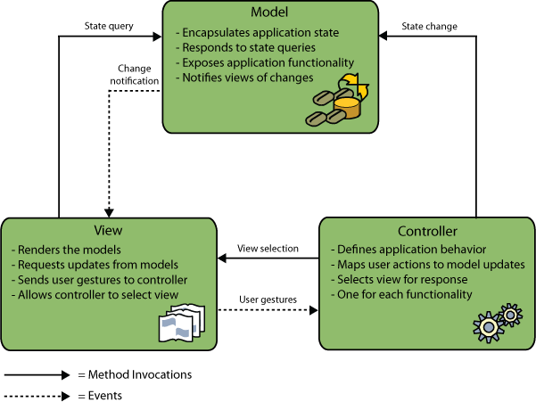
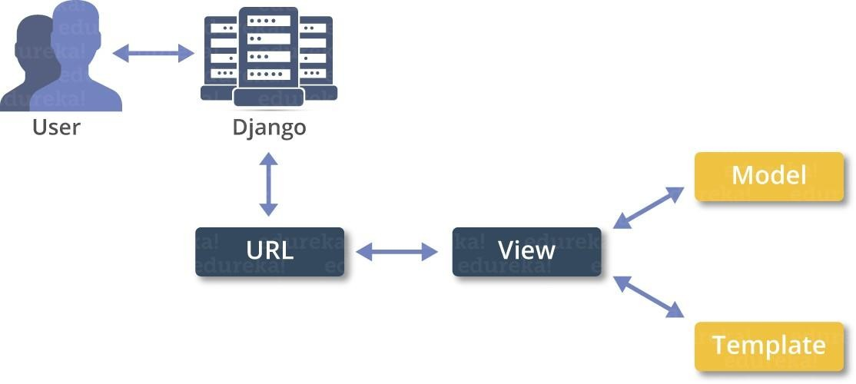
SYSTEM ARCHITECTURE

Slide 16
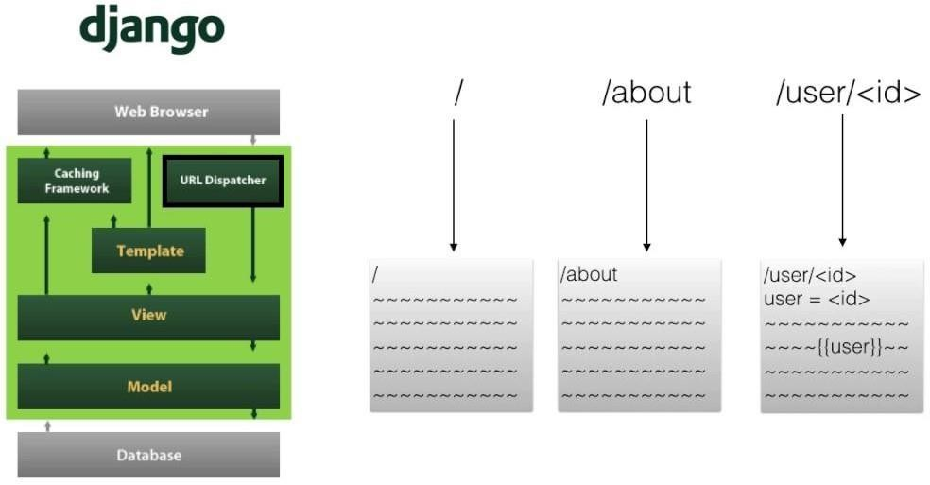
Django Structure

Slide 17
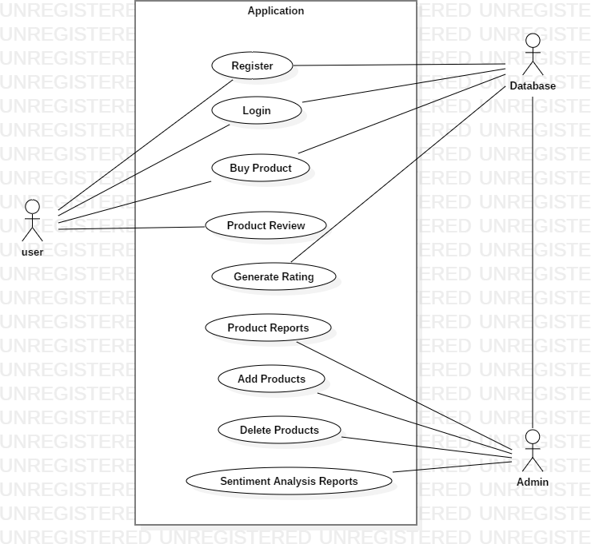
UML Diagrams
Use Case

Slide 18
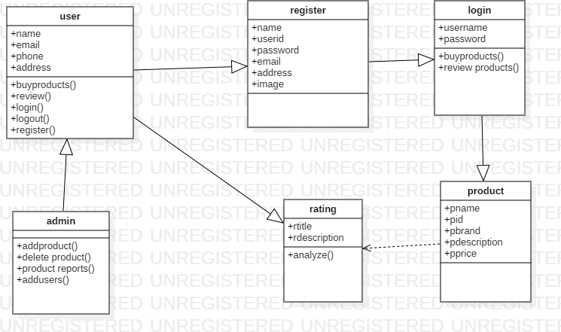
UML Diagrams
Class Diagram

Slide 19
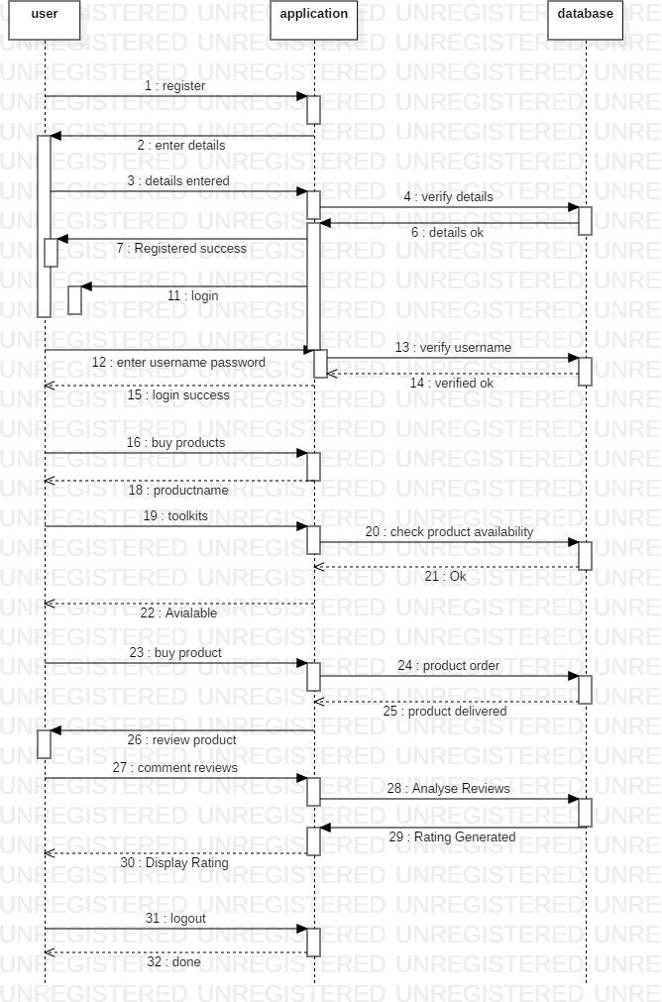
UML Diagrams
Sequence Diagram

Slide 20
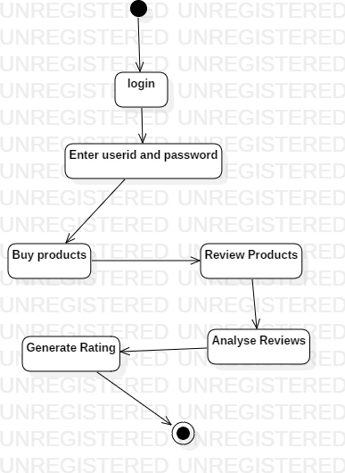
UML Diagrams
State Chart

Slide 21
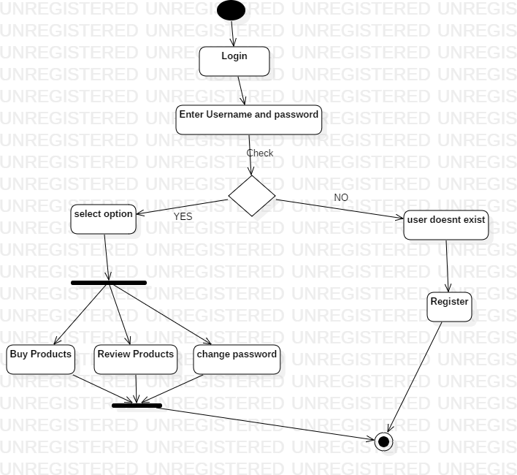
UML Diagrams
Activity Diagram

Slide 22
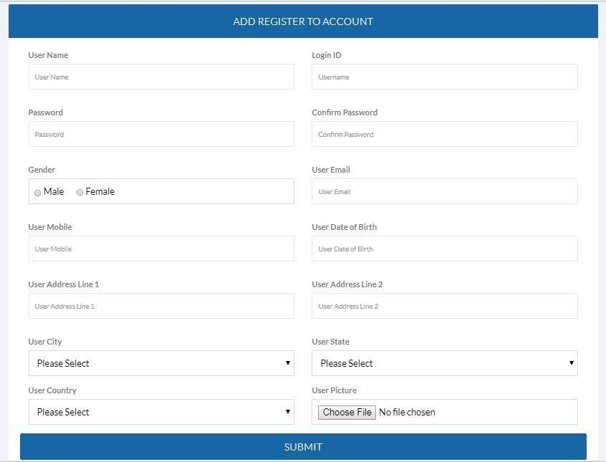
Human Interface Design
User Registration Page

Slide 23
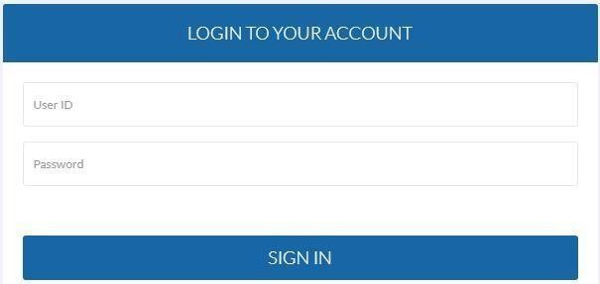
Human Interface Design
User /Admin Login Page

Slide 24
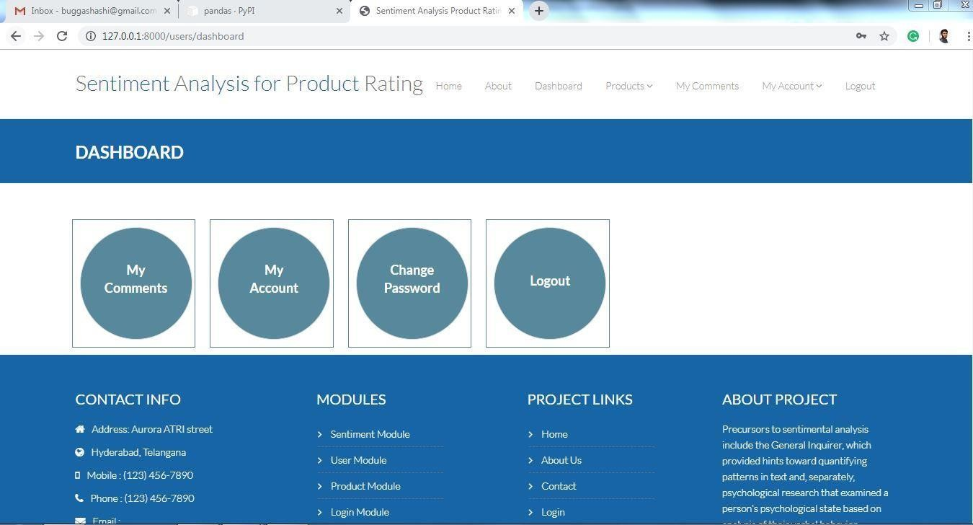
Human Interface Design
User Dashboard

Slide 25
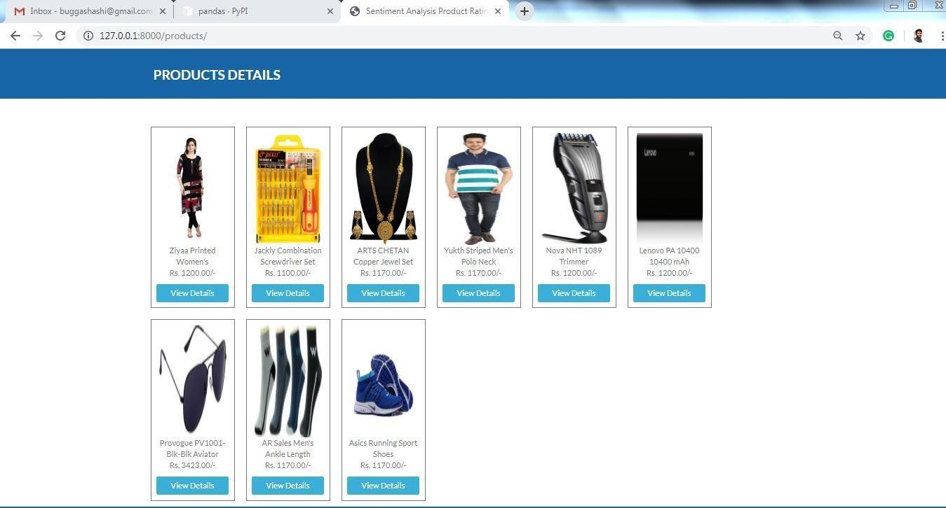
Human Interface Design
Products Page

Slide 26
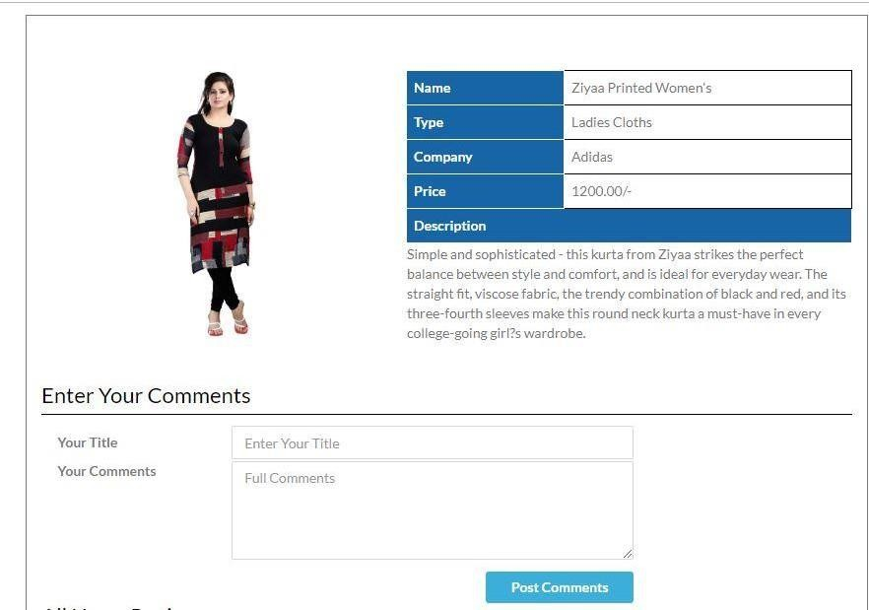
Human Interface Design
Product Review/Comments Page

Slide 27
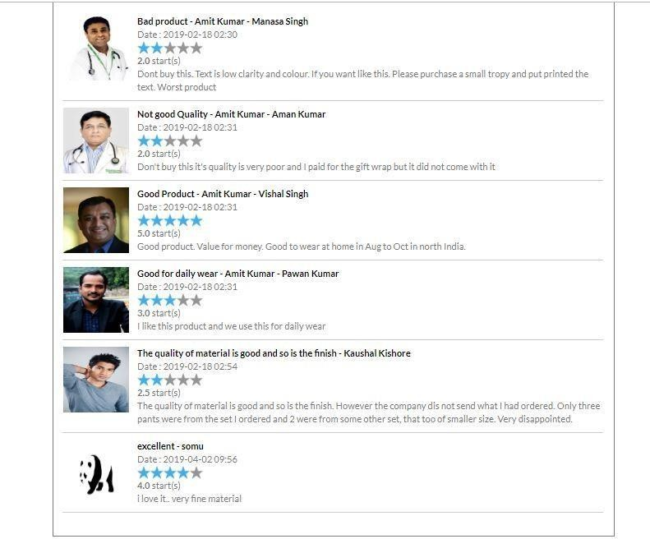
Human Interface Design
Product Ratings

Slide 28
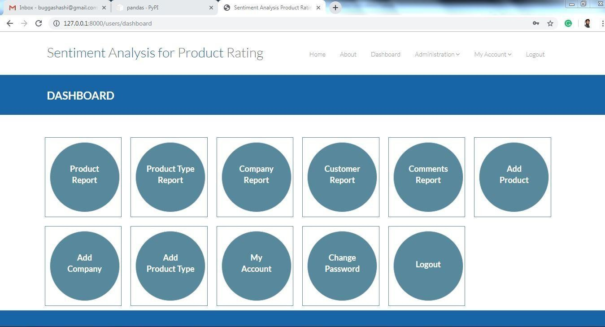
Human Interface Design
Admin Module

Slide 29
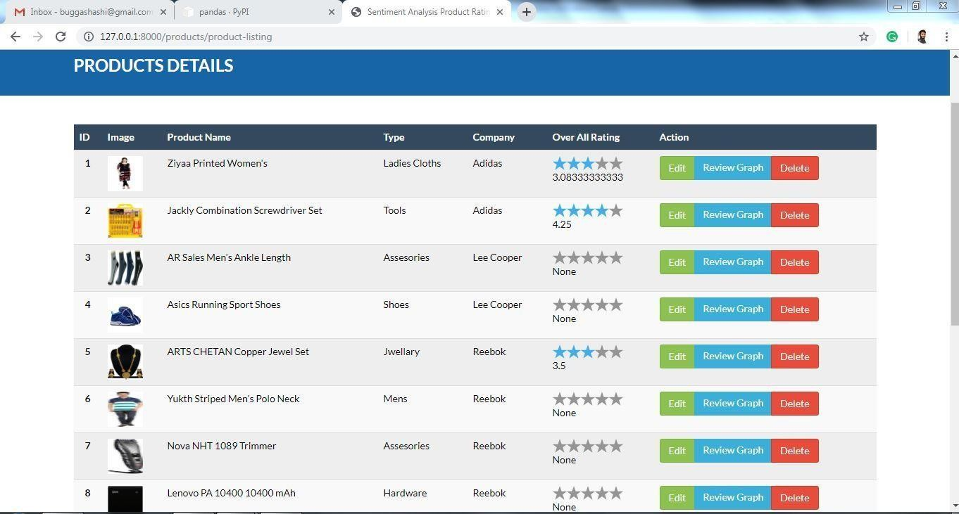
Human Interface Design
Products Operations
Module

Slide 30
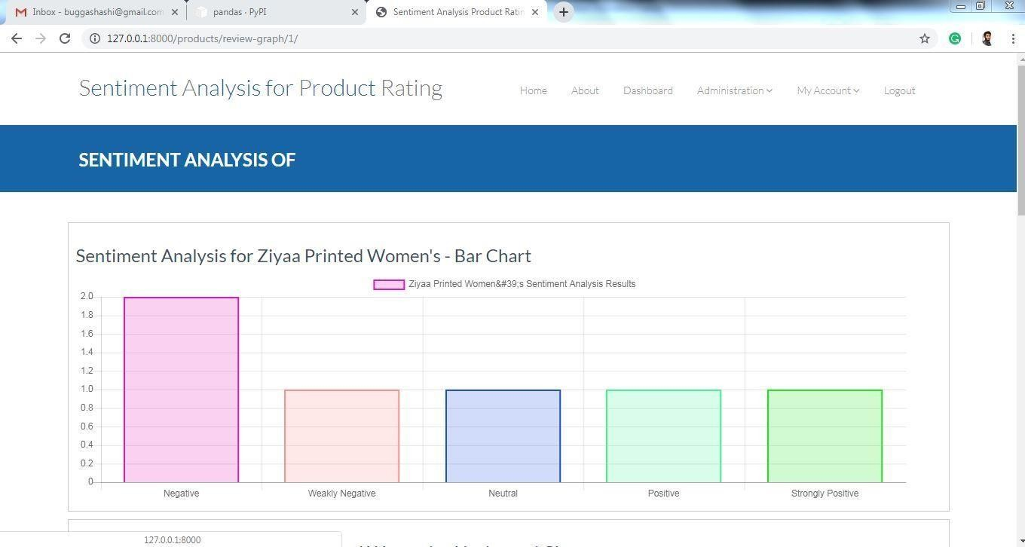
Human Interface Design
Sentiment Analysis Module

Slide 31

Key Terms
Natural Language Processing
Machine Learning
NPI Algorithm
Data Science
Future Predictions
Data Pre-Processing
NLTK Library
Pandas Library
E-Commerce
Web Technologies

Slide 32
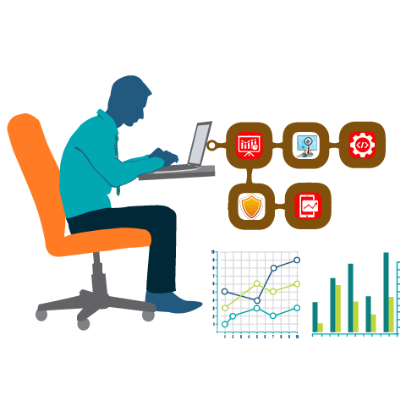
Software Requirements
Web Presentation
HTML & CSS
Bootstrap
JavaScript
Domain
Python
Web-Framework
Django
IDE’s
Spyder
Python Library
NLTK
NUMPY
Py Socks
Py Parsing
Database
SQL
Operating System
Windows – 7 / 8 / 10

Slide 33
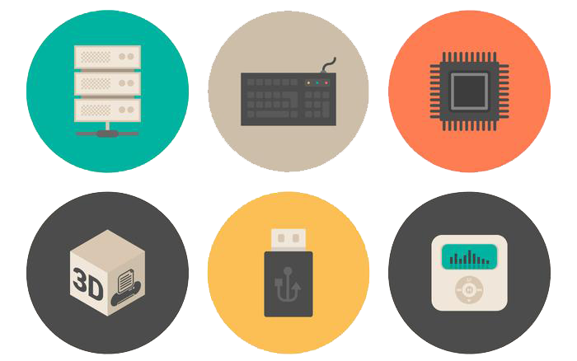
Hardware Requirements
Processor: Intel i3
RAM Capacity: 2GB
Hard Disk: 150GB

Slide 34
Conclusion & Future Scope

Slide 35

“Digital technology has several features that can make it much easier for teachers to pay special attention to all their students.”
— Bill Gates

